Slide 1
NREGA Analysis

Slide 2
NREGA Analysis Adenugba oluwajuwon mentorness internship Batch Name: MIP-DA-09

Slide 3
Project overview
This project analyses data related to the National Rural Employment Guarantee Act (NREGA), a transformative government scheme aimed at providing rural households with guaranteed wage employment opportunities.
We aim to gain valuable insights into the implementation and impact of NREGA across different states and districts in India.

Slide 4
Dataset overview
The dataset used for this analysis is sourced from official government records and contains information related to NREGA implementation across various states and districts in India.
It comprises 740 Rows and 28 columns, encompassing data on job cards, worker details, budget allocation, work completion statistics, expenditure, and more.
The dataset offers a comprehensive view of the progress and challenges faced by the NREGA program.

Slide 5
Data Cleaning
Standardized capitalization of text columns (state_name and district_name)
Data quality checks to ensure:
total expenditure = wages + material and skilled wages + admin expenditure
Total works taken up = completed works + ongoing works
Converted ‘approved labor budget’ from Rs. To Lakhs

Slide 6
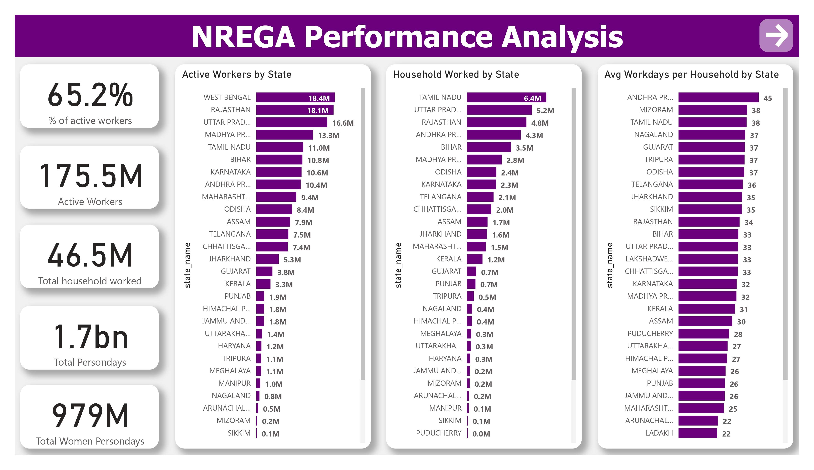
Data Analysis

Slide 7
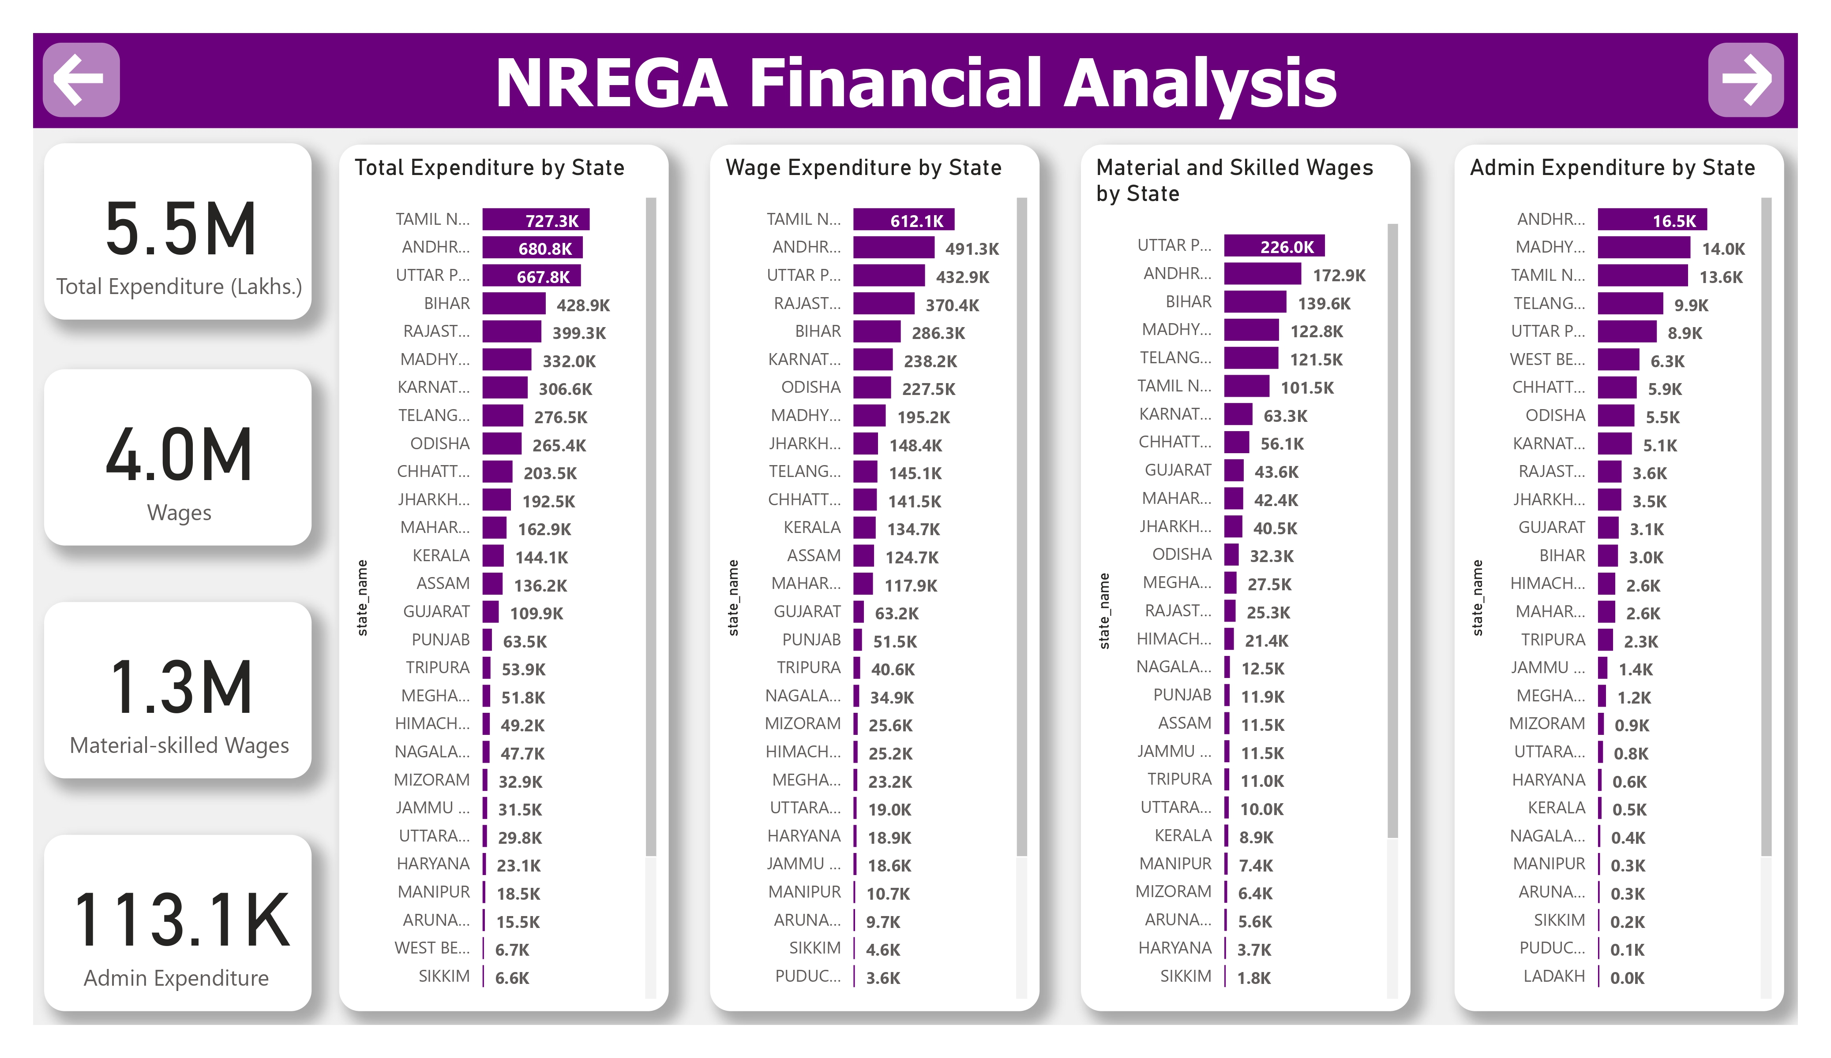
Data Analysis

Slide 8
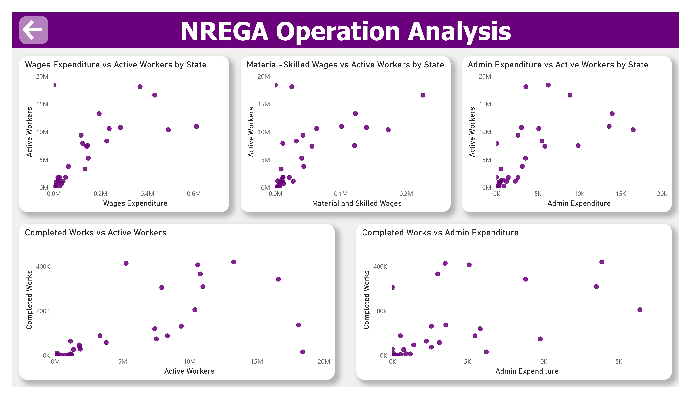
Data Analysis

Slide 9
Conclusion
This data analysis project uncovered valuable insights to support decision making with regards to the NREGA initiative.
In the future more data can be collected for better analysis
Hope you found it insightful. Drop you questions and comments
Thank YOU!!!

